Slide 1

Hip Preservation: Enhancing Mobility &
Patient Outcomes
Presented by Nimesh Patel, MD

Slide 2
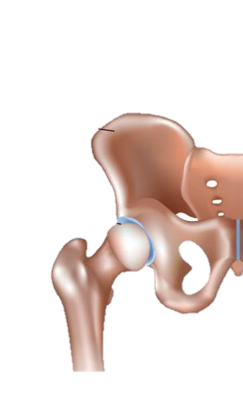
Introduction to Hip Preservation
Proactive Care to Preserve Hip Function
Hip preservation focuses on early diagnosis and intervention.
Combining non-surgical techniques (therapy, injections) with surgical options if necessary.
Goal: Prevent hip replacement and maintain an active lifestyle through early intervention.
Pelvis
Healthy Hip
Joint

Slide 3
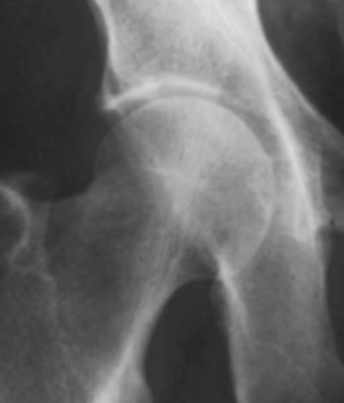
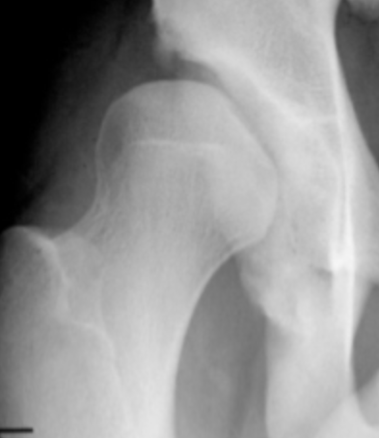
What is Hip Dysplasia?
Hip dysplasia is an abnormality of the hip joint where the socket portion does not fully cover the ball portion, resulting in an increased subtle hip joint instability.
Normal
Dysplastic

Slide 4
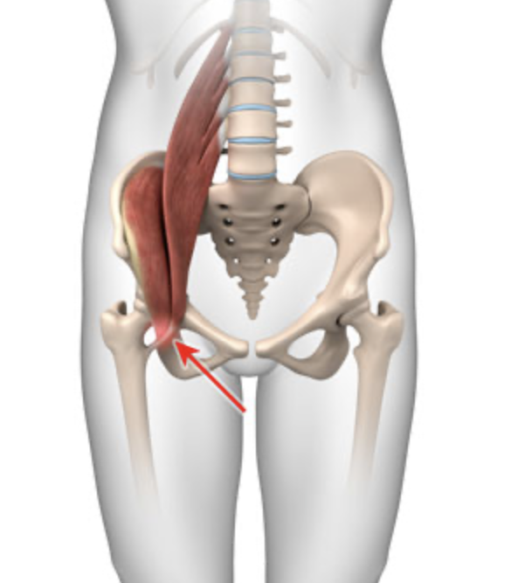
How Does Hip Dysplasia Result in Hip Pain?
Because a dysplastic acetabulum does not provide enough bony support, this creates instability for this hip joint
Hip musculature has to work overtime to provide compensatory stability
For this reason, physical therapy is the primary initial treatment
Focusing on rehabbing and strengthening these muscles is critical to help treat symptoms of hip dysplasia

Slide 5
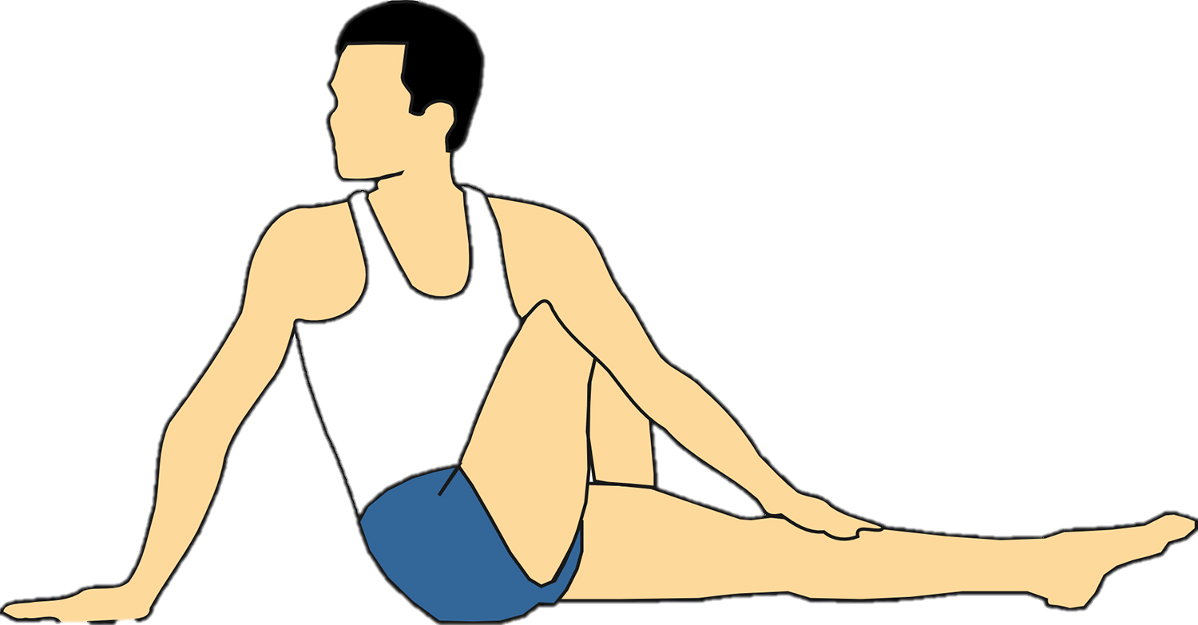
Primary Approach:
Physical Therapy
Physical Therapy as the Foundation for Treatment
PT prioritizes non-surgical management for hip pain.
Techniques include manual therapy, strengthening, core stabilization, and improving hip mobility.
Collaboration between therapists and surgeons ensures comprehensive, patient-centered care.

Slide 6
Hip Preservation
Only after failing extensive physical therapy protocols, do we consider surgical intervention.

Slide 7
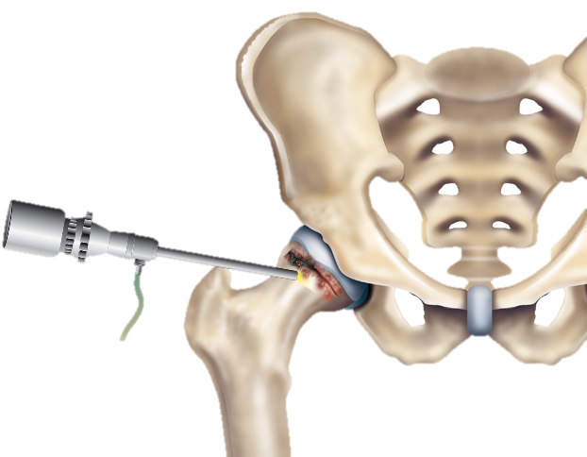
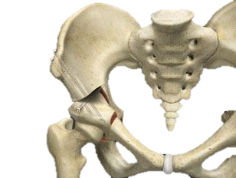
When to Consider Surgery: Hip Scope vs. PAO
Hip Arthroscopy
Minimally invasive, used for treating intra-articular issues i.e. labral tears and femoroacetabular impingement (FAI).
Periacetabular Osteotomy
Aimed at correcting hip dysplasia, stabilizing the joint by reshaping the acetabulum, and critical to protecting the hip arthroscopy repairs.
VS.

Slide 8
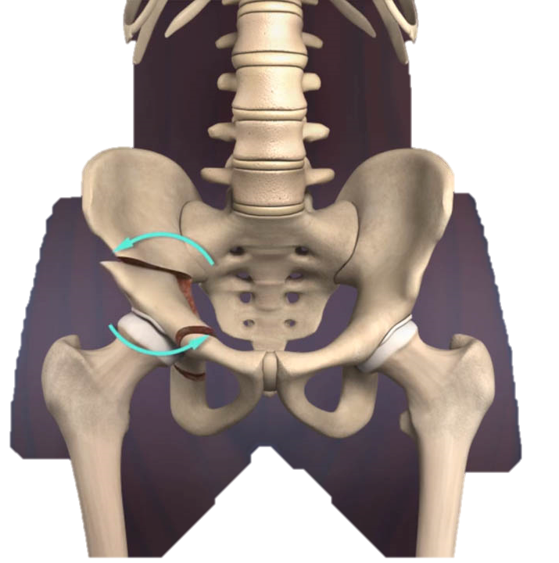
Understanding PAO Surgery
Correcting Structural Issues for Long-Term Benefits
PAO is a major reconstructive surgery that realigns the hip socket to increase coverage of the femoral head.
Reduces the risk of arthritis and delays or prevents the need for total hip replacement.
Recovery takes months, but long-term benefits are significant for young, active patients.
Goal: Avoid total hip replacement at a young age.

Slide 9


Post-Surgical Rehab Protocols
Tailored Rehabilitation for Successful Recovery
Phase 1 (0-6 weeks): Joint protection and passive ROM exercises.
Phase 2 (6-12 weeks): Gradual weight-bearing as tolerated, progressive strengthening.
Phase 3 (12+ weeks): Advanced strength training, return-to-sport.
Willingness to adapt protocols to local therapist preferences for optimal patient outcomes.
0-6 weeks
6-12 weeks
12+ weeks

Slide 10
How Physical Therapists and Surgeons Can Collaborate
Partnering for Better Outcomes
We believe strongly in open communication between surgeons and local physical therapists.
Encourage ongoing dialogue to ensure optimal recovery pathways.
Tailored rehab protocols post-surgery, designed with input from our partnering therapists for best results.
PT
Surgery
Post-Surgical Rehab

Slide 11
Let’s Collaborate for Better Patient Outcomes!
Nimesh Patel, MD
303.330.6788 (cell)
nimeshpatelmd@hippreservation.org
www.hippreservation.org

